Slide 1
Spark ML Components and Concepts
By Imran Ahmad (PhD)
imran@cloudanum.com

Slide 2
Introduction
Spark ML refers to DataFrame based spark.ml is the Spark’s Machine Learning Library
It replaces older spark.mlib package, which is now in the maintenance mode.
SparkML is the primary Machine Learning library now.

Slide 3

Relevant Data Structure
Background concepts

Slide 4
ML related Datastructures
Three important types
1- Dense Vector
2- Sparse Vector
3- Labelled Point

Slide 5
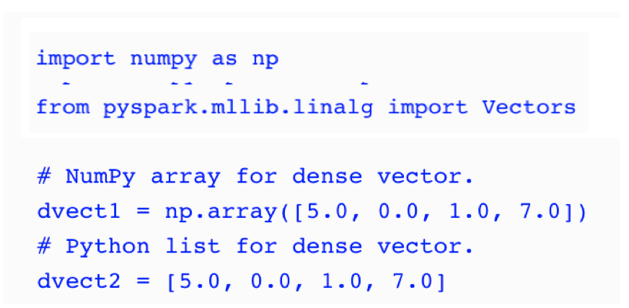
Dense Vector
Dense vector is a traditional array of doubles.
An example of dense vector is [5.0, 0.0, 1.0, 7.0].

Slide 6
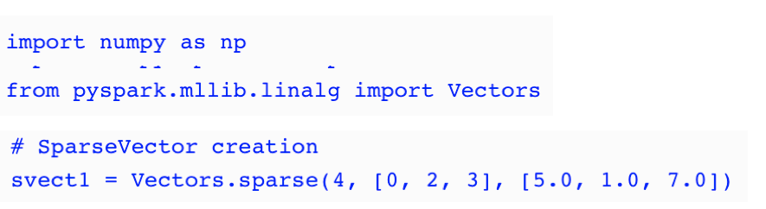
Sparse Vector
Sparse vector uses integer indices and double values.
The sparse representation of the vector [5.0, 0.0, 1.0, 7.0] would be (4, [0, 2, 3], [5.0, 1.0, 7.0])

Slide 7
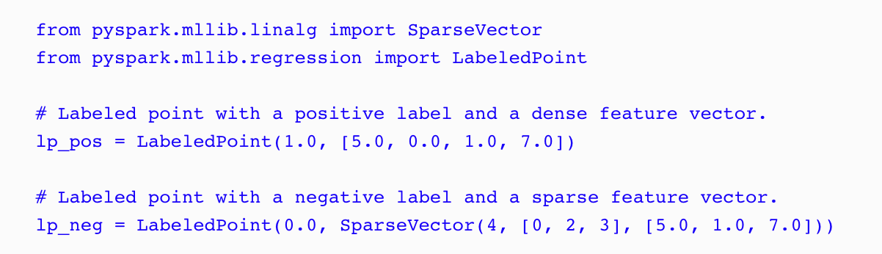
Labeled Point
A labeled point is a dense or sparse vector with a label used in supervised learning. In the case of binary labels, 0.0 represents the negative label whilst 1.0 represents the positive value

Slide 8
Spark ML Pipelines
Architecture

Slide 9
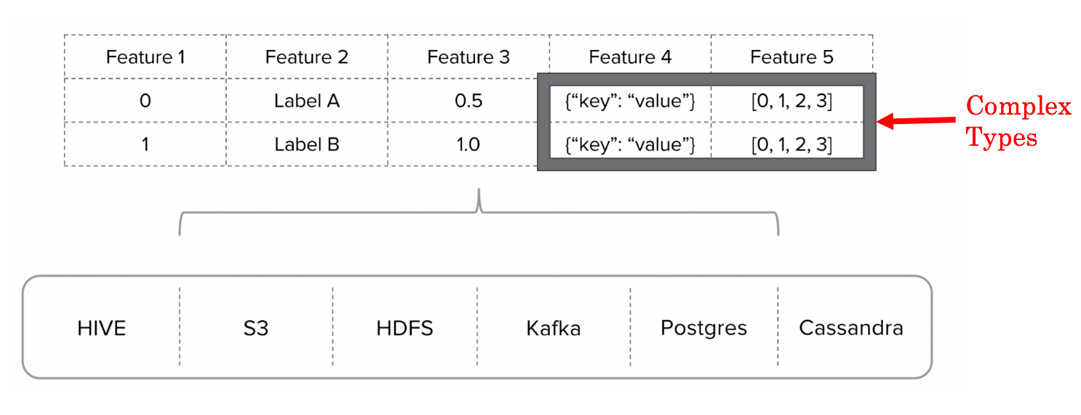
Spark DataFrame
Spark ML is DataFrame centric API
A Spark DataFrame is distributed collection of data that is organized into named columns.

Slide 10
ML Pipeline
Pipeline concept is mostly inspired by the scikit-learn project
A machine learning pipeline is a sequence of processing stages.
Each stage can either be an Estimator or a Transformer
In DEV Environment, Estimator.fit() is used to generate Model out of the training dataset along with right hyperparameters.

Slide 11
ML Pipeline components
Transformer: A function that can clean, reduce, expand or generate feature representations. Implements Transform.tranform( ) function
Estimator: An algorithm which can be fit on a DataFrame to produce a Transformer. Implements Estimator.fit( )
An Estimator can generate a Transfomer by calling fit()on a Dataframe

Slide 12
Creating Model from a Dataframe
Generation of a Model from a dataframe is called fitting a model
An Estimator is an abstraction of a learning algorithm that fits a model on a dataset.
DataFrame --[Estimator.fit( )]→ Model

Slide 13
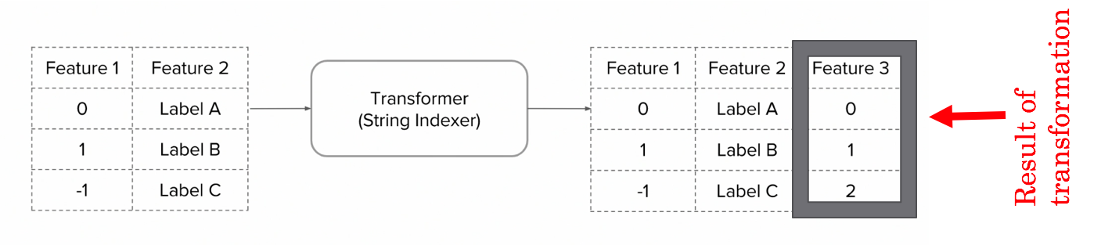
Transformers
DF1 --[Transformer.transfrom( )]→ DF2
Map functions on RDDs is now called a transfrom() within a transformer
Usually the result of transform( ) is stored in additional (feature) columns; and original input columns remain unchanged.

Slide 14
Estimators
An Estimator implements a method fit(), which accepts a DataFrame is a Transformer.
For example, a learning algorithm such as LogisticRegression is an Estimator. It implements a fit( ) function. The training data will be stored in a DataFrame and calling fit ( ) function will produce the model for that particular training data.

Slide 15
Preparing Data for ML
Methodologies and Concepts

Slide 16
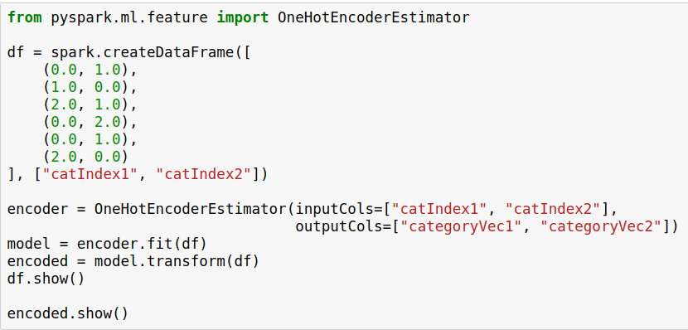
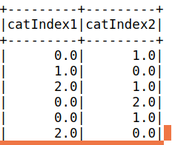
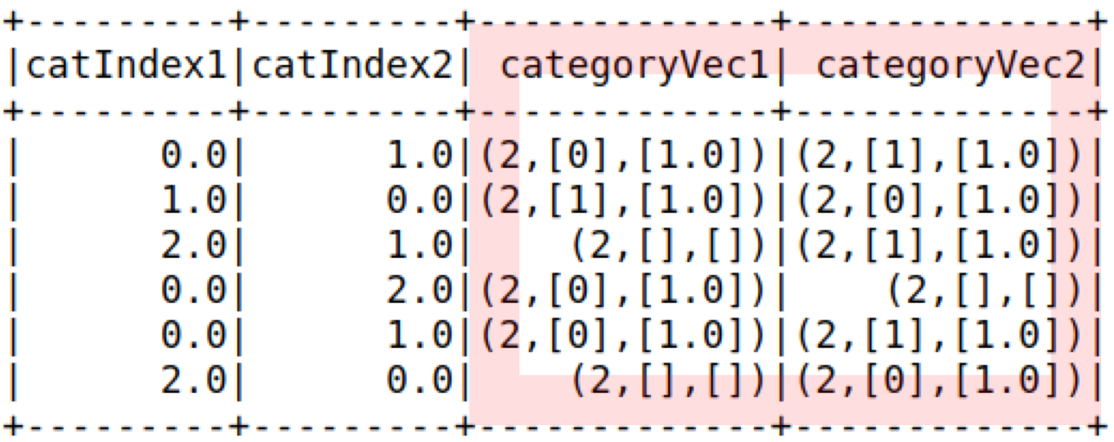
OneHotEncoder
Although machine learning algorithms are capable of making use of the colorsIndexed column, they perform better if we one-hot encode it.

Slide 17
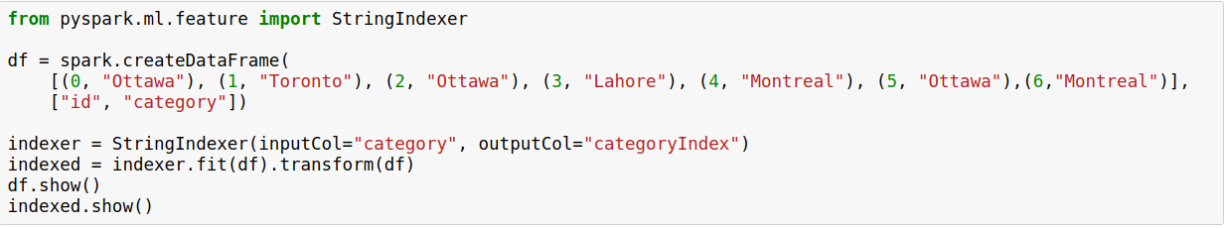
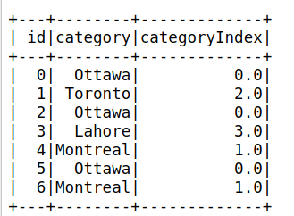
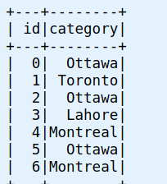
String indexer
Converts a single column to an index column

Slide 18
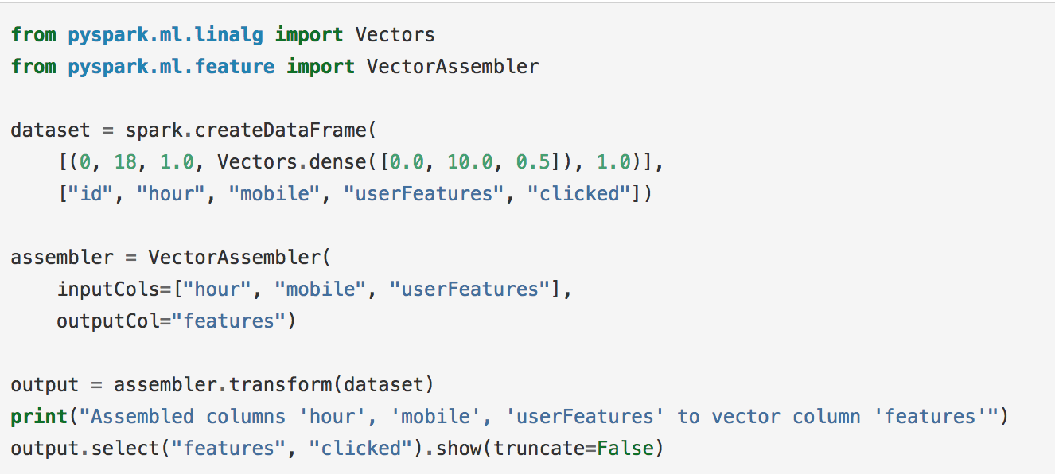

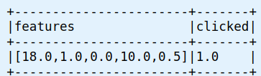
VectorAssembler
We have to create one additional feature column containing all the information of the columns that we want the machine learning algorithm to consider.

Slide 19
Summary
Spark ML replaces older spark.mlib package and is the primary Machine Learning library now.
Different ML processing stages are chained together in an ML Pipeline.
Assemblers help preparing data for Spark ML Algorithms.

